Slide 1
INTERNATIONAL FLOW OF FUNDS

Slide 2
AGENDA
  Today we will discuss
  Key components of the balance of payments.
  Growth in international trade activity over time.
  How international trade flows are influenced by economic and other factors.
  How international capital flows are influenced by country characteristics.
  Agencies that facilitate the international flow of funds.

Slide 3
THE BALANCE OF PAYMENTS
(BOP) is an accounting of a country's international transactions for a particular time period.
Any transaction that causes money to flow into a country is a credit to its BOP account, and any transaction that causes money to flow out is a debit.
The BOP includes
  the current account - mainly measures the flows of goods and services, earnings on investments, aid and grants
  the financial account, which records investment flows, such as DFI and portfolio investment
  the capital account - capital transfers and the acquisition and disposal of non-produced, non-financial assets

Slide 4
CURRENT ACCOUNT
Current Account is further differentiated into three components
Trade Income – Exports and imports of goods and services.
  Difference between exports and import is referred to as Trade Balance
Factor Income (Primary Income) - income on investments in DFI, interest and dividends
Transfer Payments (Secondary Income) - aid, grants, and gifts from one country to another, migrant remittances

Slide 5
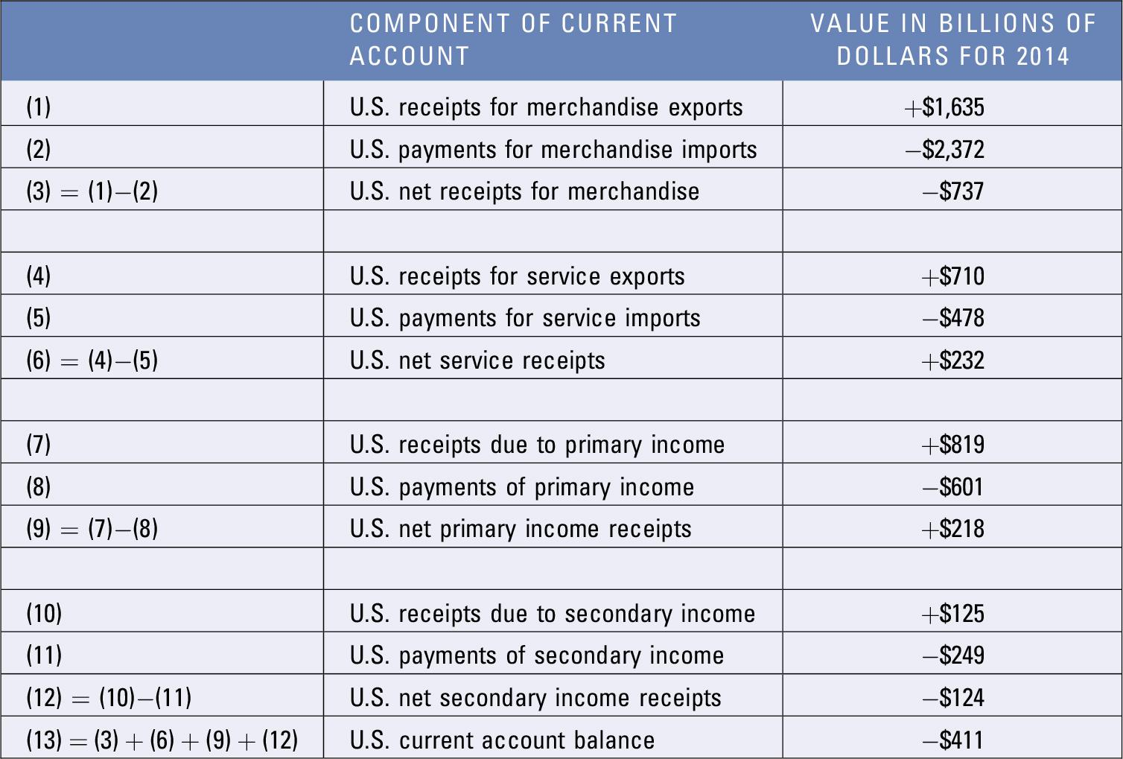
U.S. CURRENT ACCOUNT

Slide 6
FINANCIAL ACCOUNT
Financial Account
Direct foreign investment - Investments in fixed assets in foreign countries.
Portfolio investment - Transactions involving long term financial assets (such as stocks and bonds) between countries that do not affect the transfer of control.
Other capital investment - Transactions involving short-term financial assets (such as money market securities) between countries.
Errors and omissions and reserves
  Measurement errors can occur when attempting to measure the value of funds transferred into or out of a country.

Slide 7
CAPITAL ACCOUNT
Capital Account
Originally included the financial account.
Includes the value of financial assets transferred across country borders by people who move to a different country.
Includes patents and trademarks.
Relatively minor(in terms of dollar amounts) to financial account.

Slide 8
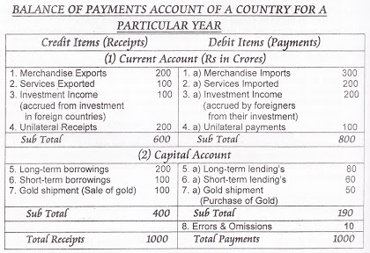
BALANCE OF PAYMENTS

Slide 9
EVENTS THAT INCREASED TRADE VOLUME
Removal of the Berlin Wall: Led to reductions in trade barriers in Eastern Europe.
Single European Act of 1987: Improved access to supplies from firms in other European countries.
North American Free Trade Agreement (NAFTA): Allowed U.S. firms to penetrate product and labor markets that previously had not been accessible.
General Agreement on Tariffs and Trade (GATT): Called for the reduction or elimination of trade restrictions on specified imported goods over a 10-year period across 117 countries.
The European Union: Free movement of products, services, and capital among member countries.
Inception of Euro: Avoid exposure to exchange rate risk.

Slide 10
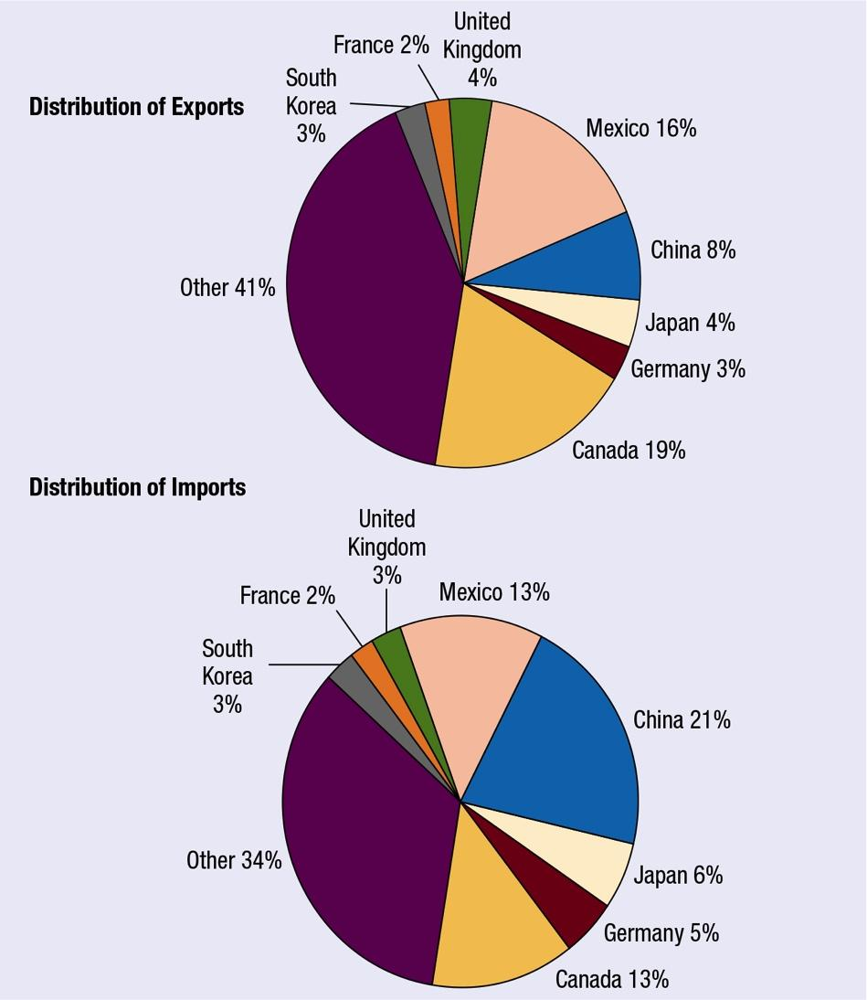
UNITED STATES
EXPORTS
AND
IMPORTS
Notes:
The annual international trade volume of the United States is between 10 and 20% of its annual GDP.

Slide 11
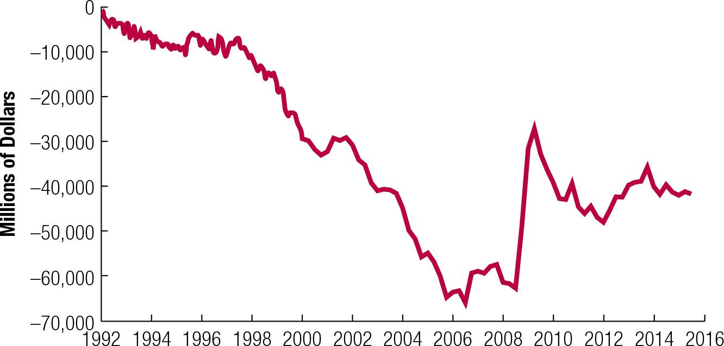
U.S. BALANCE OF TRADE OVER TIME

Slide 12
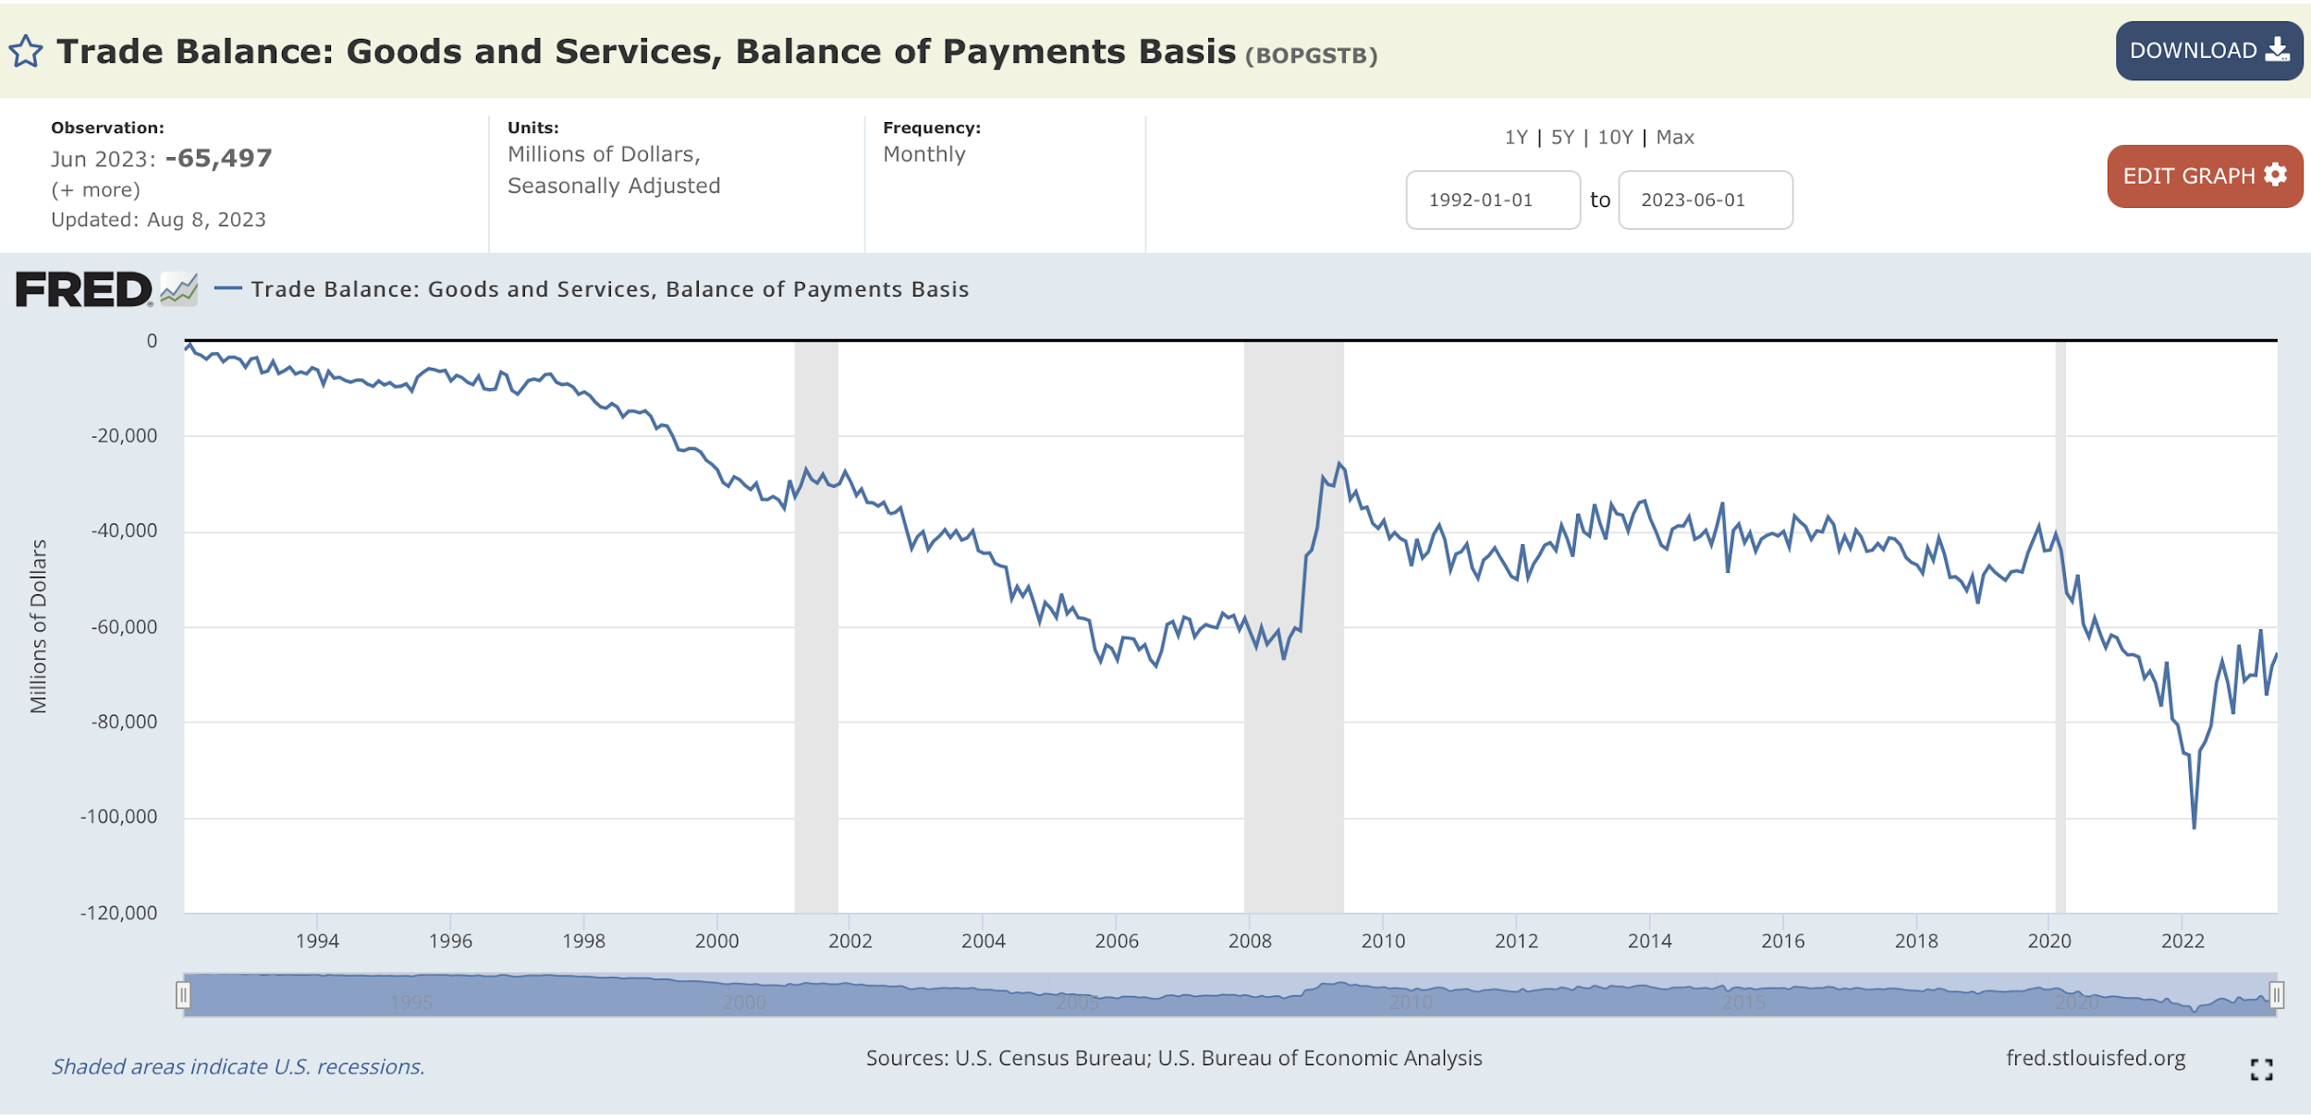

Slide 13
SUMMARY OF BALANCE OF PAYMENTS
CURRENT ACCOUNT
measures flow of funds due to trade and income generated from assets
  Payments for Goods and Services – exports and imports
    Exports-imports = trade balance = balance of trade
  Primary Income – income from investments – dividends, interest etc
  Secondary income – transfer payments for aid, grants, gifts
FINANCIAL ACCOUNT
  Direct Foreign Investment (that involves change of controlling stake)
  Portfolio Investment – purchase and sale of capital assets like stock or bonds, but without change of controlling interest
CAPITAL ACCOUNT
  Funds and assets moving across borders
  Sales of patents and trademarks

Slide 14
WHAT AFFECTS INTERNATIONAL TRADE?
Cost of Labor
Inflation
National Income
Credit conditions
Exchange Rates
Government policies

Slide 15
WHAT AFFECTS FOREIGN INVESTMENT?
Direct Foreign Investment (DFI)
Removal of government barriers
Privatization
Potential for Economic Growth
Tax Rates
Exchange Rates
International Portfolio Investment
Tax on Interest and Dividends
Interest Rates
Exchange Rates

Slide 16
IMPACT ON INTERNATIONAL CAPITAL FLOWS
The United States relies heavily on foreign investment in:
    U.S. manufacturing plants, offices, and other buildings.
    Debt securities issued by U.S. firms.
    U.S. Treasury debt securities.
Foreign investors are especially attracted to the U.S. financial markets when the interest rate in their home country is substantially lower than that in the United States.
U.S. reliance on foreign funds: In general, access to international funding has allowed more growth in the U.S. economy over time but has also made the U.S. more reliant on foreign investors.

Slide 17
AGENCIES FACILITATING INTERNATIONAL FLOW OF FUNDS
International Monetary Fund (IMF)
  Objective: Promote cooperation and flow of funds across nations
World Bank — (International Bank for Reconstruction and Development)
  Objective: Make loans to countries to promote economic growth
  🡺 the IMF focuses on macroeconomic and financial stability, while the World Bank concentrates on long-term economic development and poverty reduction.
World Trade Organization (WTO)
  forum for multilateral trade negotiations and settle disputes over GATT

Slide 18
GOVERNMENT POLICIES SUPPORTING TRADE
import restrictions
export subsidies
piracy restrictions
environmental restrictions
labor laws
business laws, red tape
tax breaks
government ownership or subsidies
country security laws
policies to punish other governments that don’t follow common laws

